Slide 1
Donor Store vs Revenue ROI Analysis
Neel Roy

Slide 2
Table of Contents
Overview of Data
Most Popular vs Least Popular Items
Linear Regression Analysis on Donations & Items Redeemed
Multiple Regression Analysis on Revenue
Revenue By Donation Type and City
DEF vs DON Logisitic Regression Analysis
Interpretation of Logistic Regression Analysis
Log-Odds
Odds Ratio
Probability
Shortcomings
Recommendations
Conclude

Slide 3
Overview of Data
Donor Store Orders data contains data from January 1, 2023 – July 18, 2024
Invoice data contains data from January 1, 2022 – June 30, 2024
Blood donor Info data contains data from January 19, 2019 – July 16, 2024

Slide 4
Most Popular vs Least Popular Items

Slide 5
Linear Regression Analysis on Donations & Items Redeemed
Lifetime Donations
Frequency of Items Redeemed
Category | Rsquared
Donor Code | 0.16869
Product Name | 0.08004
Product Order Points | 0.00974
Gender | 0.05424
Total Donor Order Points Spent | 0.04222
Age | 0.18312
Category | Rsquared
Donor Code | 0.00266
Product Name | 0.06879
Product Order Points | 0.00019
Gender | 0.03196
Total Donor Order Points Spent | 0.00472
Age | 0.00481
Rsquared scores suggest that none of the categorical variables can explain the variability of the response data. They’re essentially not good x-axis values to determine a linear relationship with donations and frequency of items redeemed.

Slide 6
Multiple Regression Analysis on Revenue
Singular Regression Analysis
Multiple Regression
Category | Rsquared
Donation Type | 0.78844
City | 0.04046
Location Field(South Bay, Menlo Park, etc) | 0.12314
Age | 0.03242
Ethnic Group | 0.01550
Gender | 0.03819
Donor ID | 0.03331
Frequency of Donation | 0.45064
Category | Rsquared
City | 0.79060
Location Field(South Bay, Menlo Park, etc) | 0.78991
Age | 0.78852
Ethnic Group | 0.78945
Gender | 0.78907
Donor ID | 0.78845
Frequency of Donation | 0.78946
The singular regression yielded Donation Type as a good variable to explain Revenue. Donation Type and City together yielded a better rsquare suggesting that the pair can better explain the variability in Revenue.

Slide 7
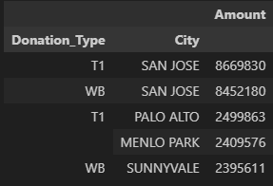
Revenue By Donation Type and City

Slide 8
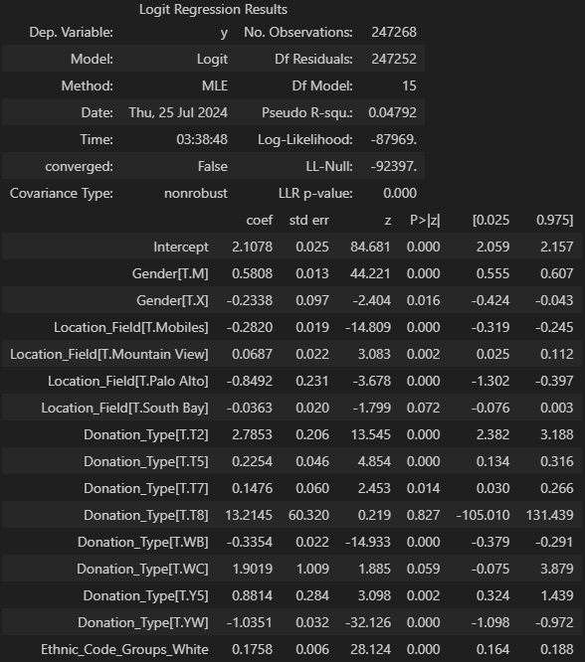
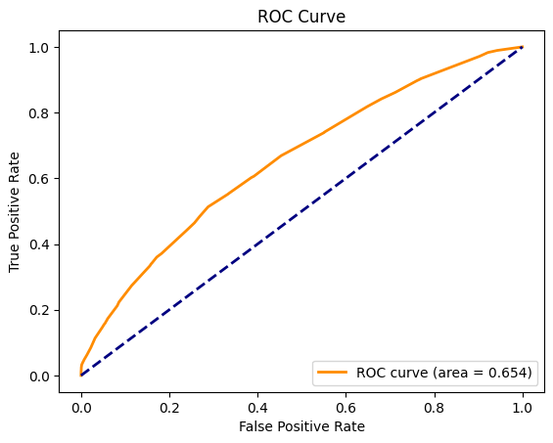
DEF vs DON Logisitic Regression Analysis

Slide 9
Interpretation of Logistic Regression Analysis
Psuedo R-squared of 0.04792 suggests that the logistic regression model weakly explains the variation of the dependent variable (DEF vs DON).
A false convergence suggests that the model is has not reached a stable solution potentially due to issues such as multicollinearity.
With these in mind, consider the log-odds, odds ratio, and probability in the following slides with caution.

Slide 10
Log-Odds
Intercept(2.1078): The intercept represents the log odds of making a donation when all other predictors are zero.
Male Gender(coefficient = 0.5808): Being male (M), compared to female (F0, increases the log-odds of donation by 0.5808.
X Gender(coefficient = -0.2338): Being of unspecified gender (X), compared to female (F), decreases the log-odds of donation by 0.2338.
White Ethnic Group (Coefficient = 0.1758): Being in the White ethnic group increases the log-odds of donation by 0.1758 compared to the rest of the ethnic groups.

Slide 11
Odds Ratio
Male Gender: Odds Ratio = exp(0.5808) = 1.788; The odds of donation are 1.788 times higher for males (M) compared to females (F), holding all other variables constant.
WB Donation Type: Odds Ratio=exp(−0.3354)=0.715; The odds of donation for Donation_Type[T.WB] are 0.715 times the odds of donation for the reference category (T1), holding all other variables constant. This suggests that Donation_Type[T.WB] is associated with lower odds of donation compared to T1.

Slide 12
Probability
Predicted probability of donation for a female donor who is not part of the white ethnic group (Ethnic_Code_Groups_White = 0) and is donating type YW blood in Palo Alto.
z=2.1078+0+(−0.8492)+(−1.0351)+0; z=0.2235
P(Donation)=1+e^−0.22351​; P(Donation)≈0.556
The predicted probability of donation for a female donor who is not part of the White ethnic group (Ethnic_Code_Groups_White = 0), donating type YW blood in Palo Alto is approximately 55.6%.

Slide 13
Shortcomings
During the analysis, it was challenging to link the ROI on redemption items because the unit number doesn’t necessarily correlate to an item redeemed. It was difficult to link exactly how much ROI SBC was receiving from the donor store items. Data with long-term revenue may have made the analysis easier.
The logistic regression model is not 100% reliable. If more time was allowed, regularization methods such as LASSO or Ridge Regression or K-fold cross validation could’ve been done to eliminate some collinearity to make the model more reliable.

Slide 14
Recommendations
From an operational standpoint, discontinuing certain unpopular donor store items such as dog ball launchers, sticker packs, and dog leashes (to name a few) can reduce costs for SBC.
Since gift cards do seem to be the most effective incentive, it may be worth conducting research on what gift cards specifically attract more donors(brands, restaurants, etc. not $ amount).
The white ethnic group, males, and people aged 50-69 tend to donate the most which is why SBC receives most of their revenue from these demographics. It may be worthwhile to add donor store items that appeal to these demographic groups. Alternatively, it may be worthwhile to add donor store items that appeal to demographic groups apart from the ones named if SBC is looking to gain donors from demographic groups that don’t currently donate as much.

Slide 15
Thank You!

